Slide 1

Introduction to Deception Techniques (honey-*)
Harish Ramadoss(@hramados)

Slide 2
Agenda
Deception ?
Techniques we will demo
HoneyHash - Fake Memory Credentials
Kerberoasting Service Accounts Honey Tokens
Honey Files
For Red Team – Detecting Honey-*

Slide 3
Deception ?

Slide 4
HoneyHash - Fake Memory Credentials

Slide 5
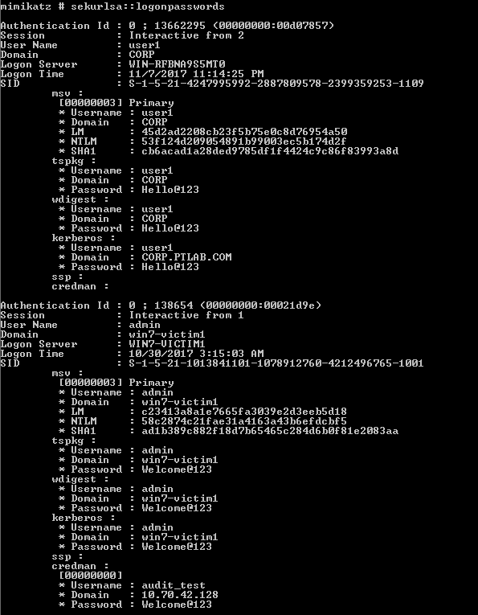
Mimikatz

Slide 6
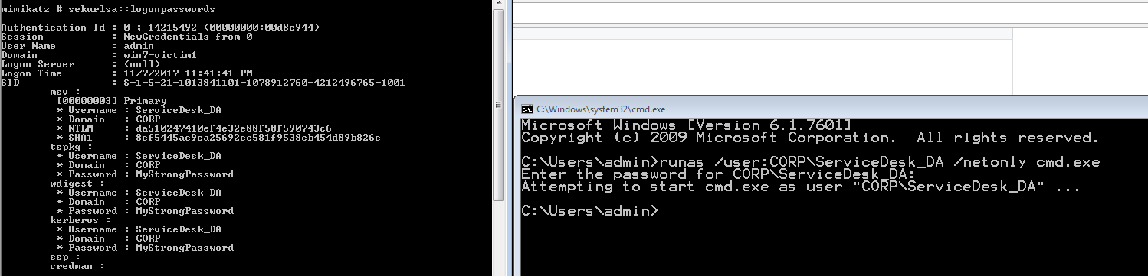
Injecting Honey Hash

Slide 7
Deploying Honey Hash across the infrastructure
Create a privileged account on AD, set a very strong password & forget
Set Logon Hours to NONE
Inject the HoneyHash across the infrastructure using GPO
Look for authentication failures coming from the staged accounts
Reference :
SANS Reference -> https://isc.sans.edu/forums/diary/Detecting+Mimikatz+Use+On+Your+Network/19311/
Powershell -> https://github.com/EmpireProject/Empire/blob/master/data/module_source/management/New-HoneyHash.ps1

Slide 8
Kerberoasting Service Accounts Honey Tokens

Slide 9
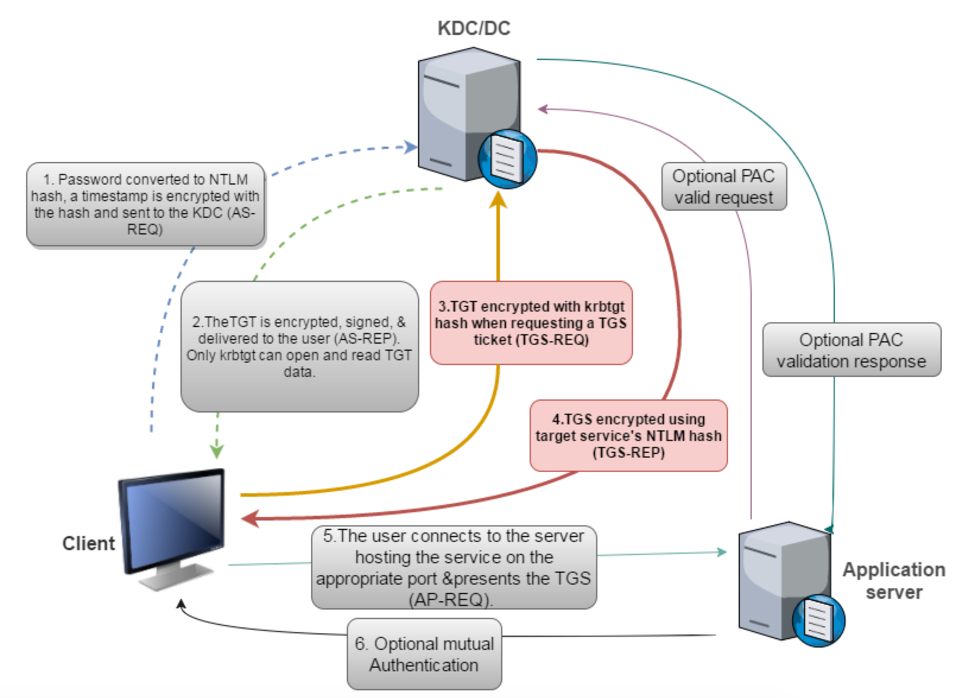
Kerberoast Overview
Source : http://www.labofapenetrationtester.com/

Slide 10
Kerberoast Overview
Crack Password for Remote Service Accounts
Without sending a single packet to the service
As any user
Without local admin
Offline cracking (No Failed logins)
Source : https://www.sans.org/summit-archives/file/summit-archive-1493862736.pdf

Slide 11
Kerberos SPN ?
Your System doesn’t know (or need to know) the account running the service
The KDC does need this info so it can properly encrypt the server
Setsepn.exe is used to an AD account to a service
Source : https://www.sans.org/summit-archives/file/summit-archive-1493862736.pdf

Slide 12
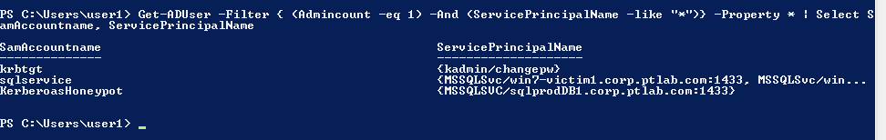
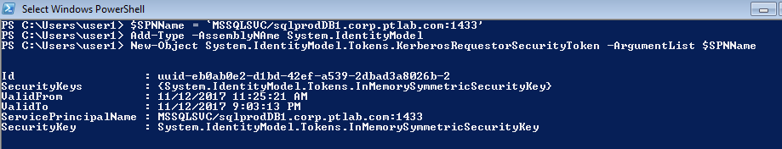
Attacker Requesting for TGS

Slide 13
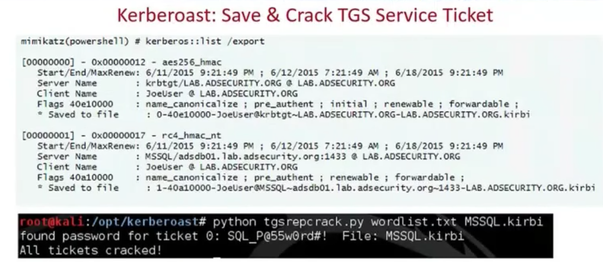
Cracking TGS Ticket
Source : https://www.sans.org/summit-archives/file/summit-archive-1493862736.pdf

Slide 14
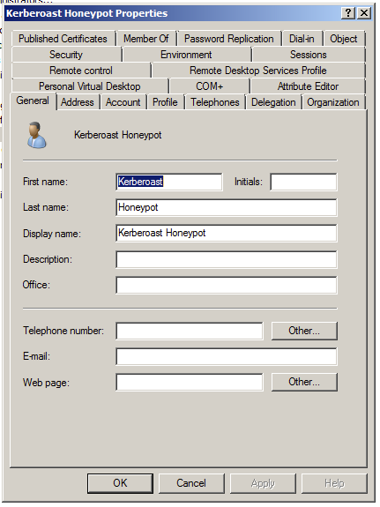
Fake Service Account

Slide 15
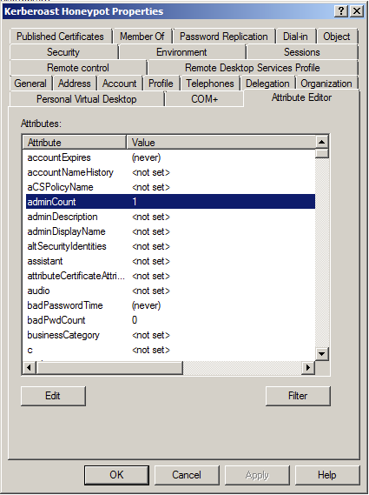
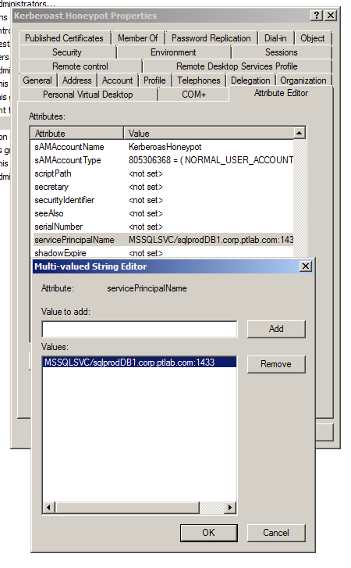
Fake Service Account Attributes

Slide 16
Log – Showing Request for TGS

Slide 17
Deploying Kerberoasting Service Accounts Honey Tokens
Create a user account and set a strong password & forget
Set Admin Account=1 & SPN=<Fake Service Name>
Add the accounts to fake groups to make it more interesting
Monitor for Event ID ->4769
Reference
Kerberoasting -> https://adsecurity.org/?p=2293
Detecting Kerberoasting -> https://adsecurity.org/?p=3513

Slide 18
HoneyFiles

Slide 19
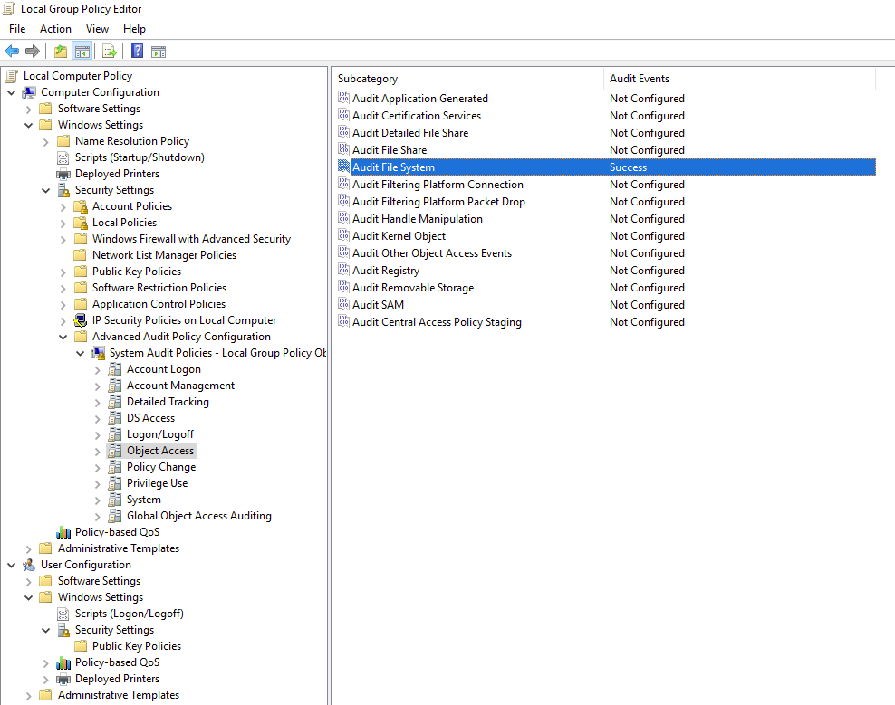
Enable Auditing

Slide 20
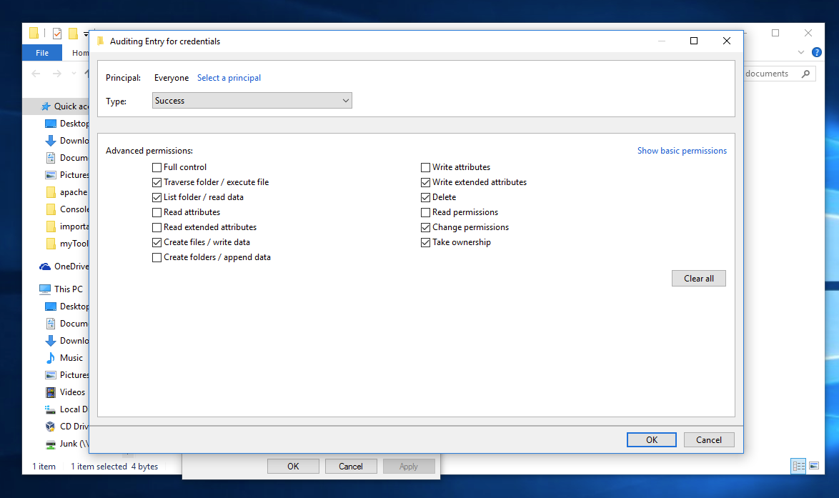
Enable Auditing

Slide 21
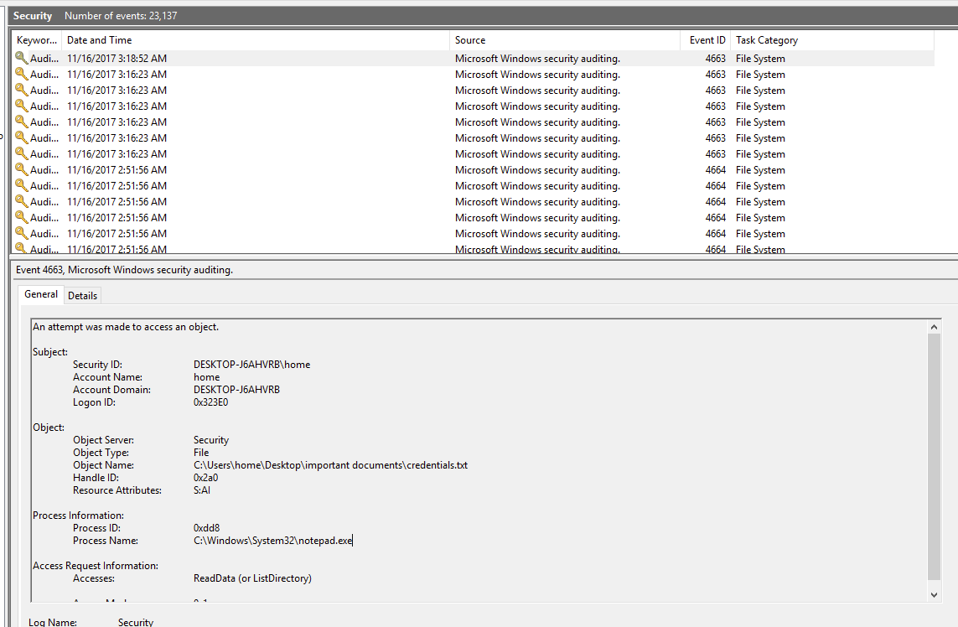
Enable Auditing

Slide 22
Deploying HoneyFiles
“Audit File System” found in “Advanced Audit Policy Configuration” must be configured to “Success” within group policy
Create Honeypot files on file shares and set enable Auditing
Monitor for Event ID -> 4663
Reference
Detecy Honeyfile Access -> https://labs.mwrinfosecurity.com/blog/using-windows-file-auditing-to-detect-honeyfile-access/

Slide 23
Detecting Honey-*
Honeypot Buster - Powershell tool to identify honey-*
Review “logon server” & “NewCredentials from” flags – It can be a indication it’s a honeyhash
When performing Kerberoast attacks, identify if the service account is in a privileged ground and if the account is recently active
Inactive user honeytoken
Note : Above all are just indicators and not a definite way of detecting

